Slide 1
Additional Problems Solution

Slide 2
Section 1

Slide 3
Additional Problems
Write SELECT statements
Example 3
Rank item brands descending by average dollar sales in 2014 and 2015
Show item brand, average dollar sales, and rank
Example 4
Rank item brands by average dollar sales in 2014 and 2015
Only include brands with more than 10 sales in 2014 and 2015
Show item brand, number of sales (COUNT), average dollar sales, and rank
Notes:
Use rank function
Grouping and non grouping

Slide 4
Example 3: Solution
-- Rank item brands descending by average dollar sales in 2014 and 2015
-- Show item brand, average dollar sales, and rank
SELECT ItemBrand, AVG(SalesDollar) AS AvgSales,
RANK() OVER (ORDER BY AVG(SalesDollar) DESC) AS AvgSalesRank
FROM SSSales, SSItem, SSTimeDim
WHERE SSSales.ItemID = SSItem.ItemId AND SSSales.TimeNo = SSTimeDim.TimeNo
AND TimeYear BETWEEN 2014 and 2015
GROUP BY ItemBrand;

Slide 5
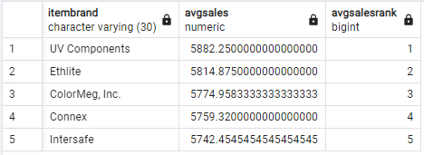
Example 3: Solution

Slide 6
Example 4: Solution
-- Rank brands by average sales in 2014 and 2015
-- Only include brands with more than 10 sales in 2014 and 2015
SELECT ItemBrand, AVG(SalesDollar) AS AvgSales, COUNT(*) AS RowCount,
RANK() OVER (ORDER BY AVG(SalesDollar) DESC) AS AvgSalesRank
FROM SSSales, SSItem, SSTimeDim
WHERE SSSales.ItemID = SSItem.ItemId AND SSSales.TimeNo = SSTimeDim.TimeNo
AND TimeYear BETWEEN 2014 and 2015
GROUP BY ItemBrand
HAVING COUNT(*) > 10;

Slide 7
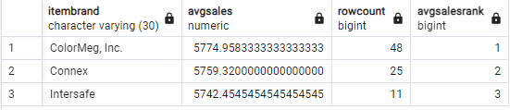
Example 4: Solution

Slide 8
Section 2

Slide 9
Additional Problems
Example 3
Dense rank item brands descending by the number of sales rows
Partition ranking by year
Only include brands with more than 5 sales in a year
Show item brand, year, count, and dense rank in the result
Example 4
Rank (both) item brands by descending sum of dollar sales in 2014
Partition rankings by month
Show item brand, month, sum of sales, and ranks (both)
Notes:
Include both ranking functions in example 4

Slide 10
Example 3: Solution
-- Rank brands on number of sales rows partitioned by year
-- Remove brands with less than or equal to 5 sales in a year
SELECT ItemBrand, TimeYear, COUNT(*) AS RowCount,
RANK() OVER (PARTITION BY TimeYear
ORDER BY COUNT(*) DESC) AS RankRowCount,
DENSE_RANK() OVER (PARTITION BY TimeYear
ORDER BY COUNT(*) DESC) AS DRankRowCount
FROM SSSales, SSItem, SSTimeDim
WHERE SSSales.ItemID = SSItem.ItemId AND SSSales.TimeNo = SSTimeDim.TimeNo
GROUP BY ItemBrand, TimeYear
HAVING COUNT(*) > 5;

Slide 11
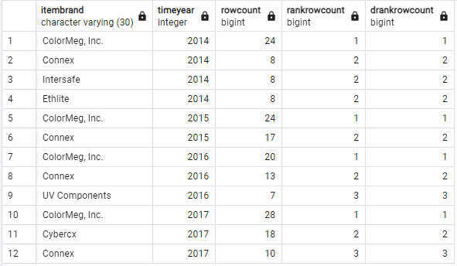
Example 3: Solution

Slide 12
Example 4: Solution
-- Rank brands on sum of 2014 sales partitioned by month
-- Use both ranking functions
SELECT ItemBrand, TimeMonth, SUM(SalesDollar) AS SumSales,
RANK() OVER (PARTITION BY TimeMonth
ORDER BY SUM(SalesDollar) DESC) AS RankSumSales,
DENSE_RANK() OVER (PARTITION BY TimeMonth
ORDER BY SUM(SalesDollar) DESC) AS DRankSumSales
FROM SSSales, SSItem, SSTimeDim
WHERE SSSales.ItemID = SSItem.ItemId AND SSSales.TimeNo = SSTimeDim.TimeNo
AND TimeYear = 2014
GROUP BY ItemBrand, TimeMonth;

Slide 13
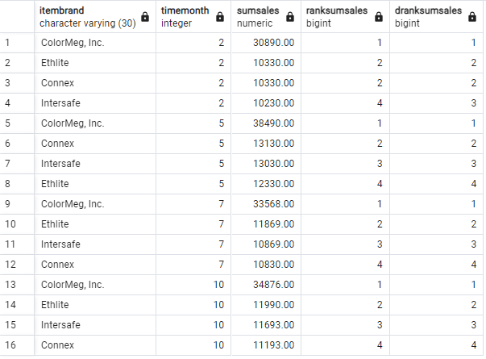
Example 4: Solution

